Slide 1
Enzymes and Chemical Reactions
2-4

Slide 2
Useful Abbreviations
E_{A} = Activation Energy
Rxn= Reaction(s)
∆= Change

Slide 3
Chemical Reactions
Processes that change one set of chemicals into a new set.
Bonds are always broken to form new bonds.
CO₂ + H₂O H₂CO₃
Reactants- Elements or compounds that enter a chemical reaction.
Products- Elements or compounds produced in a chemical reaction.

Slide 4
Energy and Reactions
Energy is released or absorbed due to bonds breaking and forming.
Energy changes determine likelihood of reactions occuring.

Slide 5
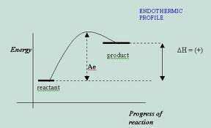
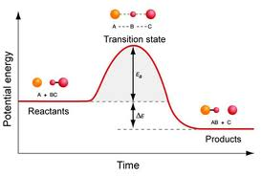
If energy is released, the reaction is most likely to happen spontaneously.
If energy is absorbed, the reaction needs energy for the reaction to occur.

Slide 6
Activation Energy
Energy needed to start a reaction.
Activation Energy

Slide 7
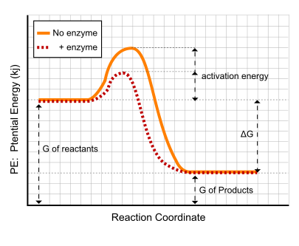
Enzymes
Proteins that act as catalysts.
Substances that speed up reactions by lowering activation energy.

Slide 8
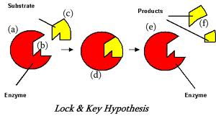
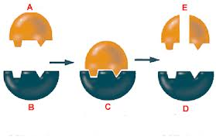
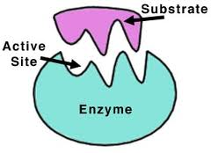
Enzyme Action
Enzymes provide a place for reactions to occur.
Reactants in a enzyme catalyzed reaction are called substrates.

Slide 9
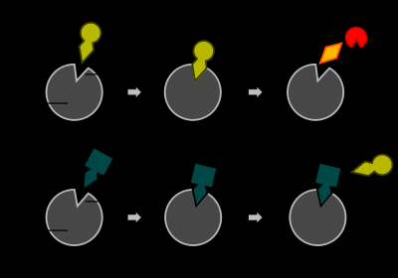
Regulating Enzymes
pH
Temperature
Protein “light” switches

